Slide 1

Snowflake Training
January, 2019
Notes:
Introductions
Tell us your role, your experience/knowledge of Snowflake, what you work on, and what you hope to take away from today

Slide 2
Materials
Slides: https://bit.ly/2H8CoIb
Lab: https://bit.ly/2TKPooY
Snowflake Instance: https://js51932.us-east-1.snowflakecomputing.com/

Slide 3
Training Agenda
Topic | Time | Subjects Covered
Architecture Overview | 9:15 - 10:30 | Intro to cloud data warehouse Snowflake in the Enterprise Data Landscape Snowflake Documentation & resources Snowflake at Discover: discussion & Q/A
Technical Overview | 10:45 - 12:00 | Snowflake file structure Query history Security Performance & optimization Scaling basics
Workshop Part 1 | 1:00 - 2:30 | Snowflake GUI overview Demo and overview of tabs User credentials & access History and troubleshooting tips
Workshop Part 2 | 2:45 - 4:00 | Sample problems Hands-on development Discussion of Discover-specific workloads
Notes:
Interactive training - tell us how you perform workloads today and what questions you have about doing them in Snowflake
Ask questions - any relevant topics don’t explicitly cover will be put into a parking lot and discussed
Discover-specific workloads in the 2nd workshop session are open to discussion

Slide 4
About Snowflake
Snowflake is a true, Data Warehouse as a Service (DWaaS), cloud offering
There is no hardware (virtual or physical) for you to select, install, configure, or manage:
Snowflake runs completely on cloud infrastructure
All components of Snowflake’s service (other than an optional command line client), run in a public cloud infrastructure
There is no software for you to install, configure, or manage
Ongoing maintenance, management, and tuning is handled by Snowflake
Notes:
Comparisons to other databases
on-prem: Oracle, SQL Server, Teradata
Cloud: Redshift

Slide 5
Architecture Overview
Snowflake Training

Slide 6
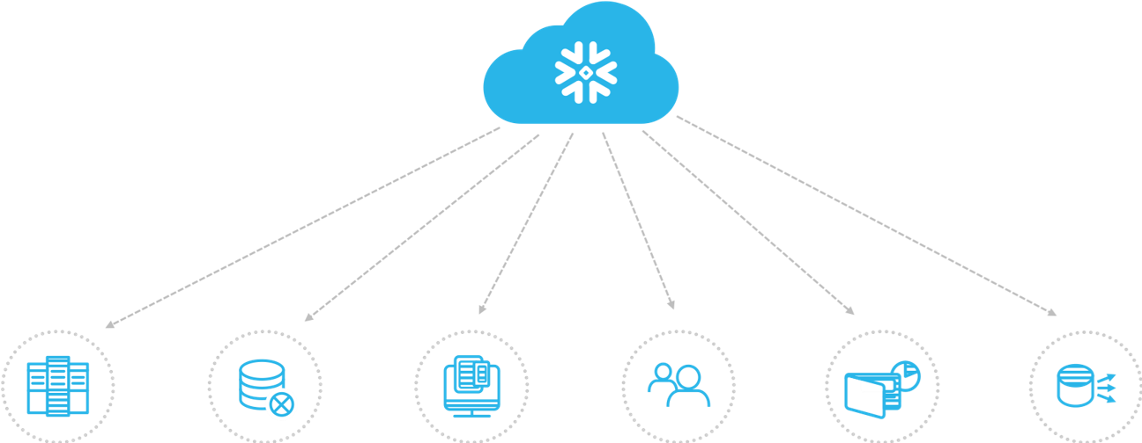
Data Warehouse Built For The Cloud
Complete SQL Database
Zero Management
All of
Your Data
All of
Your Users
Pay Only for What You Use
Live Data Sharing
Notes:
Snowflake was built from scratch to optimize the best of what the cloud has to offer—unlimited scalability and concurrency. Snowflake is delivered as a complete data warehouse as a service.
Don’t need to learn a new language
Your focus is on optimizing SQL and designing tables effectively
Data is stored centrally and immutable
For example, when a table, schema, or database is dropped, it is not immediately overwritten or removed from the system. Instead, it is retained for the data retention period for the object, during which time the object can be restored
All users can view the same data in different ways based on RBAC and view designs
Data sharing goes beyond this course, but can think of secure views as a similar concept
Supported File Formats
The following file format types are supported for COPY transformations:
CSV
JSON
Avro
ORC
Parquet
XML

Slide 7
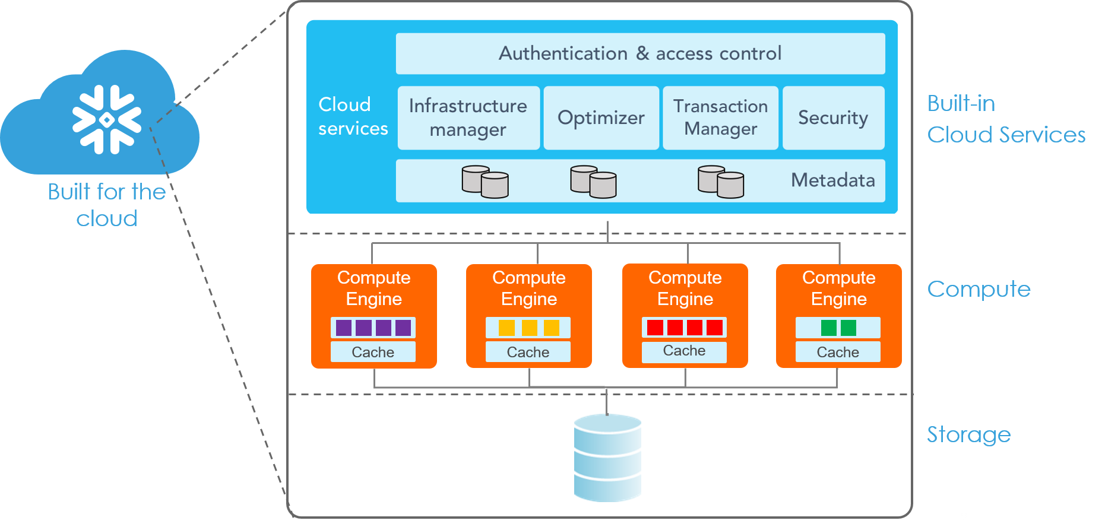
Layered Architecture
7
Notes:
Cloud services layer: Cloud services layer: Data protection, security, query compilation and metadata management, all built-in
The cloud services layer is a collection of services that coordinate activities across Snowflake. These services tie together all of the different components of Snowflake in order to process user requests, from login to query dispatch. The cloud services layer also runs on compute instances provisioned by Snowflake from the cloud provider.
Among the services in this layer:
Authentication
Infrastructure management
Metadata management
Query parsing and optimization
Access control
Query Profile, available through the Snowflake web interface, provides execution details for a query. For the selected query, it provides a graphical representation of the main components of the processing plan for the query, with statistics for each component, along with details and statistics for the overall query.
Data processing layer: virtual warehouses
When a query is executed, the result is persisted (i.e. cached) for a period of time (currently 24 hours). At the end of the time period, the result is purged from the system.
If a user repeats a query that has already been run, and the data in the table(s) hasn’t changed since the last time that the query was run, then the result of the query is the same. Instead of running the query again, Snowflake can simply return the same result that it returned previously. This substantially reduces query time because Snowflake bypasses query execution and, instead, retrieves the result directly from the cache.
The number of load operations that run in parallel cannot exceed the number of data files to be loaded. To optimize the number of parallel operations for a load, recommend aiming to produce data files roughly 10MB to 100MB in size compressed.
Data is sorted in the order it was loaded unless you specify cluster keys
Troubleshooting can be performed by querying COPY_HISTORY metadata tables
Storage layer: where the databases reside
Databases and schemas are used to organize data stored in Snowflake:
A database is a logical grouping of schemas. Each database belongs to a single Snowflake account.
A schema is a logical grouping of database objects (tables, views, etc.). Each schema belongs to a single database.
Tables and views are the primary objects created and maintained in database schemas:
All data in Snowflake is stored in tables.
Views can be used to display selected rows and columns in one or more tables.
UDFs
UDFs (user-defined functions) can be used to perform operations that are not available via the system-defined functions provided by Snowflake. Snowflake provides the following DDL commands for creating and managing UDFs
List of system scalar/table functions: https://docs.snowflake.net/manuals/sql-reference-functions.html
Overview of UDFs (javascript & SQL): https://docs.snowflake.net/manuals/sql-reference/udf-overview.html

Slide 8
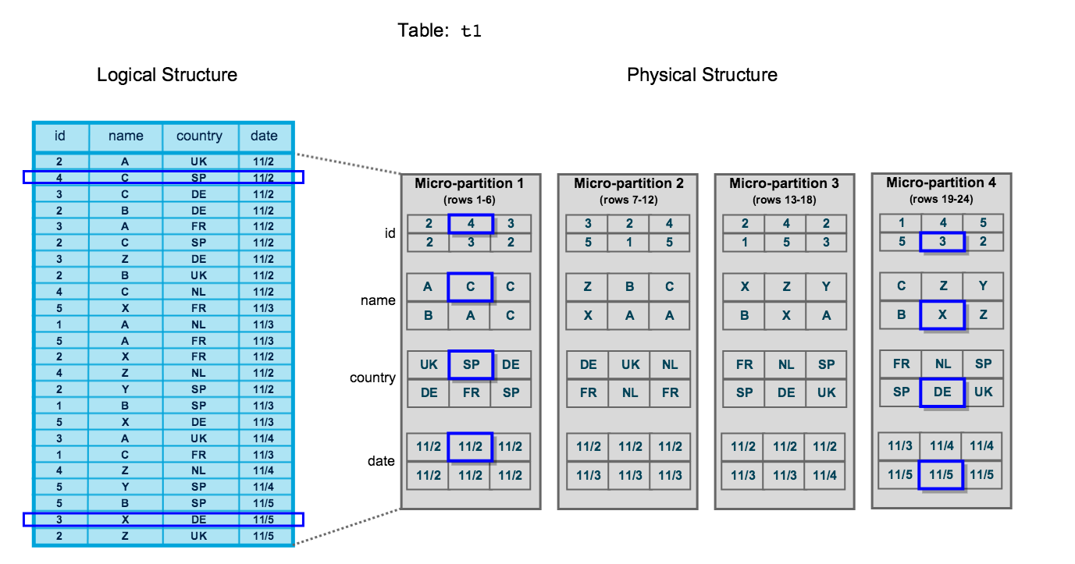
Columnar Design
Column Store database built for analytics
Enables extremely fast analytics processing
Architecture built for huge aggregations and computations
Columnar data stored in micro-partitions
Notes:
Describe concept of immutable data (data is not updated, but micropartitions are added, with the old micropartitions kept, and metadata updated.)
This enables time travel (and things like UNDROP)
Whiteboard data loading: Data is in S3 twice. First as the source format, and then again as Snowflake proprietary micro partitions
Whiteboard an example of columnar storage - 123;456 - John;Sally - Chicago;Chicago - 100;500
Updates are expensive
Stored in micro-partitions - will discuss in more detail in second section, but high level:
All data in Snowflake tables is automatically divided into micro-partitions, which are contiguous units of storage. Each micro-partition contains between 50 MB and 500 MB of uncompressed data (note that the actual size in Snowflake is smaller because data is always stored compressed). Groups of rows in tables are mapped into individual micro-partitions, organized in a columnar fashion. This size and structure allows for extremely granular pruning of very large tables, which can be comprised of millions, or even hundreds of millions, of micro-partitions.
Snowflake tracks metadata about all rows stored in a micro-partition, including:
The range of values for each of the columns in the micro-partition.
The number of distinct values.
Additional properties used for both optimization and efficient query processing.
Recommend bulk copy over insert
Overhead on every insert (about 2 seconds), doesn't matter so much between writing 1 row versus 20000 rows
Bulk insert can load up to a terabyte a minute

Slide 9
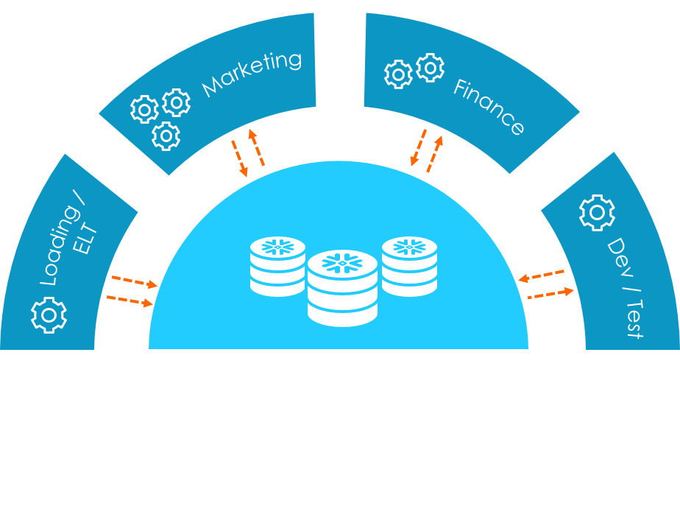
Separation of Storage and Compute
Storage separated from compute
Multiple compute clusters (“virtual warehouses”)
Virtual warehouses concurrently access data without contention
Notes:
- Draw on whiteboard how this would work with data, views, secure views - single data storage, multiple ways to view it
-Column store database purpose built for analytics not OLTP workloads, and at the core use a storage format called “block columnar”, and store these blocks on Amazon S3
-Eleven 9’s of reliability and durability with automatic replication of data across availability zones as well as replication of data when it is heavily accessed
-As data is loaded into Snowflake tables, it is columnarized, compressed, and broken into millions of blocks on S3--each containing subset of rows
-Stored in Metadata repository that is utilized by the query planner
-The second layer— compute later –is implemented using what call “Elastic Virtual Warehouses” which are clusters of EC2 instances
-Essentially the MPP cluster for processing
-Each instance contain local disks, but since do not store any data locally, this space can be used for caching and temp space while queries are being executed
-One huge advantage of not using local storage is that Virtual Warehouses can be spun up and down without needing to load and unload data
-They can be resized on demand and additional virtual warehouses can be in order to provide more compute as required all sharing the same exact underlying data in S3
-So that’s one copy of the database with multiple compute warehouses
-And conceptually this is really key - In order to run queries on snowflake you have to utilize a virtual warehouse, which is the compute
Use Cases:
-Long term scaling for the future without needing to know exactly what hardware requirements will be required
-ETL Warehouse loads and data availability after the commits
-Zero copy clones for Finance / departments who wishes to have a consistent view
-Zero Copy Clones for test/dev
-Secure views - hide sensitive data via RBAC

Slide 10
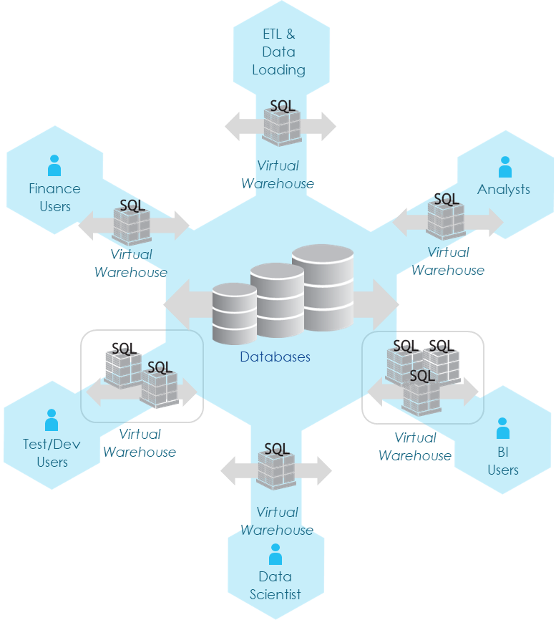
Instant & Unlimited Scalability
Scale data storage automatically as data is inserted into tables
Scale compute capacity by adding independent warehouses
Automatically scale concurrent workloads with multi-cluster warehouses
Notes:
-So then coupled with that the other element that customers pay for in Snowflake is compute
-For every hour that you run a compute cluster based on the size of that cluster you are going to incur charges on a credit hour basis
-collect statistics for how much compute is utilized, and at the end of the month, that bill comes due – in a similar fashion as you cell phone does
-do have customers who prepay for certain amount of compute at reduce the cost per credit hour, but it’s still all consumption-based
-The service layer is transparent to the user, and they don’t pay for it.
-It’s strictly the amount of data that they store in the system, and how much compute is consumed
-So looking at this diagram a single compute cluster and data stored in a database would represent a base system or an MPP cluster as in any other analytical database
-The thing about Snowflake is how it scales – Storage in Snowflake scales automatically
-Just a collection of tables where you can apply permissions across those tables easily
-As you add data to tables in snowflake, the system simply scales out, no need to worry about running out of space because it just scales out automatically
-You don’t have to worry about planning for capacity years out, and over-provisioning
-Scale out happens instantly and you don’t have to worry about resizing your footprint
-As the data grows, you’re generally going to want to add compute to handle varied workloads
-The first way to scale compute is to add additional virtual warehouses
-see customers initially segmenting there data loading workloads from their query workloads (think about global and multi-national companies)
-Segmenting off analysts who use tools like Tableau
-In Snowflake you can isolate these workloads unlike any other system
-Data science workloads which require a tremendous amount of compute for a short period can be spun up and spun down
-And then any of these Virtual Warehouses can be resized on demand by issuing a simple command
-Manually
-Programatically
-Instantaneously while queries are being executed
-Because are a columnar MPP solution, the real way to scale up is to add additional compute to an individual cluster
-Then taking it to the next level, and individual warehouse can scale out by adding additional clusters
-This is our multi-cluster option and this scales out automatically (Snagajob)
-Snowflake gives you a number of ways to scale your compute and you storage independently
-It’s all instant and the only limit is Amazon’s cloud and the customer’s ability to pay
-Amazon gives us a scalable platform that allows us to have provide as much compute as our customers need

Slide 11
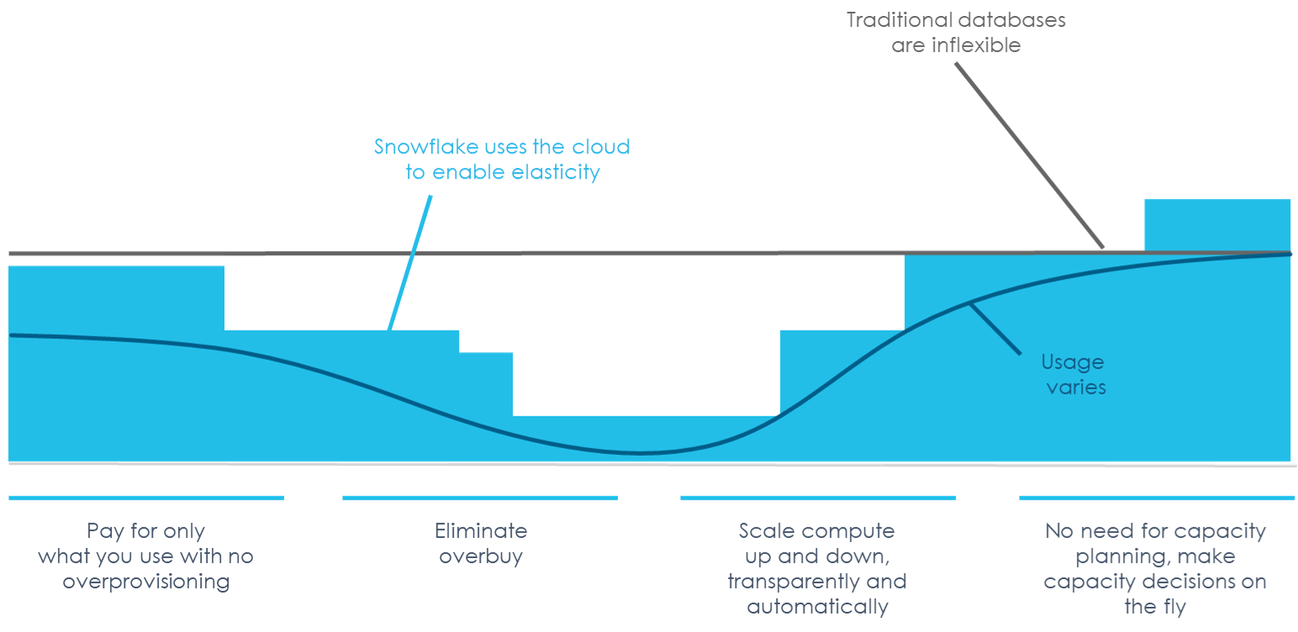
Scale On-Demand
Notes:
In general, a warehouse will handle 10-25 concurrent queries
A dashboard will probably handle more users than heavy SQL users
Separate warehouses are independent
Can scale a single warehouse with 1(xs)-128(4xl) nodes
When there is a multi-cluster warehouse, all the clusters have to be the same size
Resizing a warehouse doesn’t have any impact on statements that are currently being executed by the warehouse. When resizing to a larger size, the new servers are used only to execute statements that are already in the warehouse queue, as well as all future statements submitted to the warehouse.

Slide 12
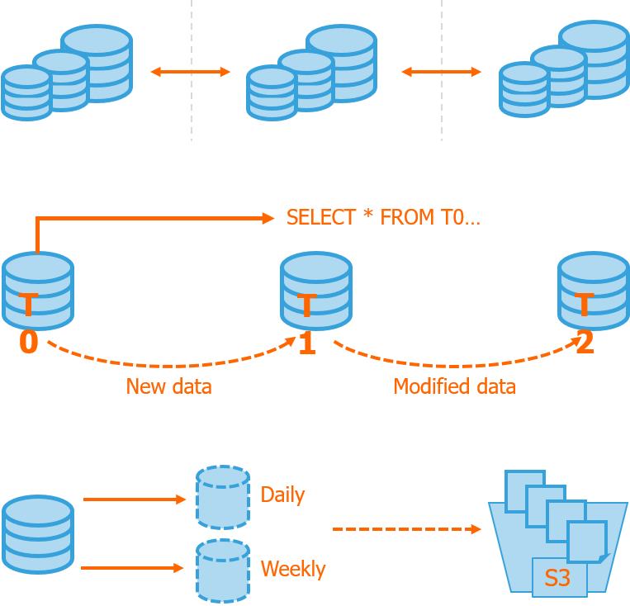
Comprehensive Data Protection
Protection against infrastructure failures
All data transparently & synchronously replicated 3+ ways across multiple datacenters
Protection against corruption & user errors
“Time travel” feature enables instant rollback to any point in time within retention window
Long-term data protection
Zero-copy clones + optional export to S3 enable user-managed data copies
Notes:
https://docs.snowflake.net/manuals/user-guide/data-time-travel.html
Using Time Travel, you can perform the following actions within a defined period of time:
Query data in the past that has since been updated or deleted.
Create clones of entire tables, schemas, and databases at or before specific points in the past.
Restore tables, schemas, and databases that have been dropped.
Fix your mistakes and better troubleshoot queries from yourself and your team When any DML operations are performed on a table, Snowflake retains previous versions of the table data for a defined period of time. This enables querying earlier versions of the data using the AT | BEFORE clause. This clause supports querying data either exactly at or immediately preceding a specified point in the table’s history within the retention period. The specified point can be time-based (e.g. a timestamp or time offset from the present) or it can be the ID for a completed statement (e.g. SELECT or INSERT).

Slide 13
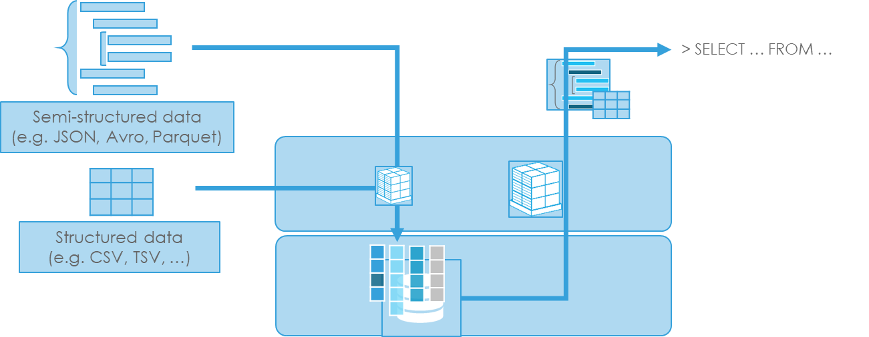
Support for Structured and Semi-Structured Data
Query Optimization
JSON paths in SQL queries
Full database optimization for queries on semi-structured data
Storage Optimization
Transparent discovery and storage optimization of repeated elements
Notes:
Discover is primarily structured today
Can discuss how to properly design tables throughout the course interactively
Referential Integrity = informational only

Slide 14
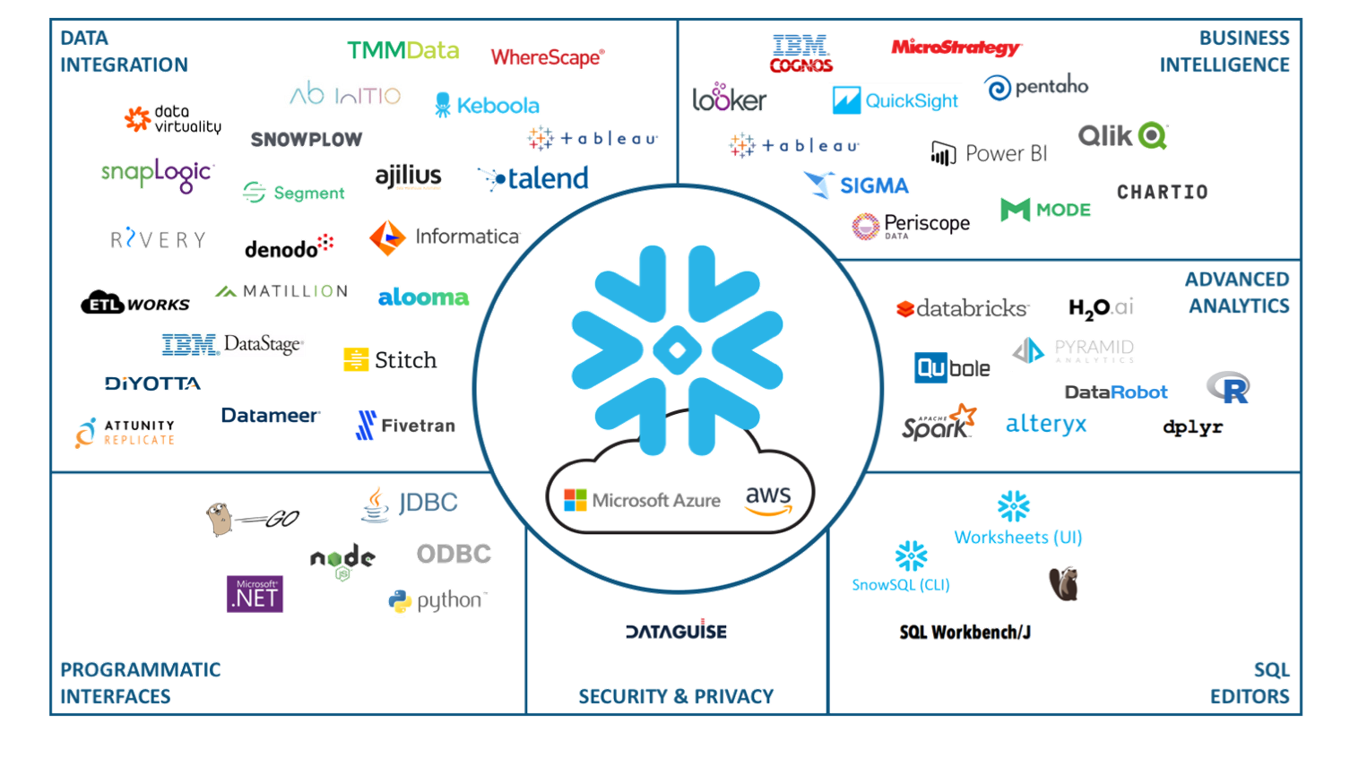
Snowflake in the Enterprise Data Landscape
Notes:
Snowflake-provided client software: SnowSQL (CLI), Python, Node.js, JDBC, ODBC, Go, .NET,
Certified partners who have developed cloud-based and on-premises solutions for connecting to Snowflake through our drivers and connectors.
Other 3rd-party tools and technologies that are known to work with Snowflake.
At Discover: Tableau dashboards can be designed to take advantage of Snowflake’s caching
Questions to trainees - are there any other tools you have been using in other databases that you want to contrast with Snowflake?

Slide 15
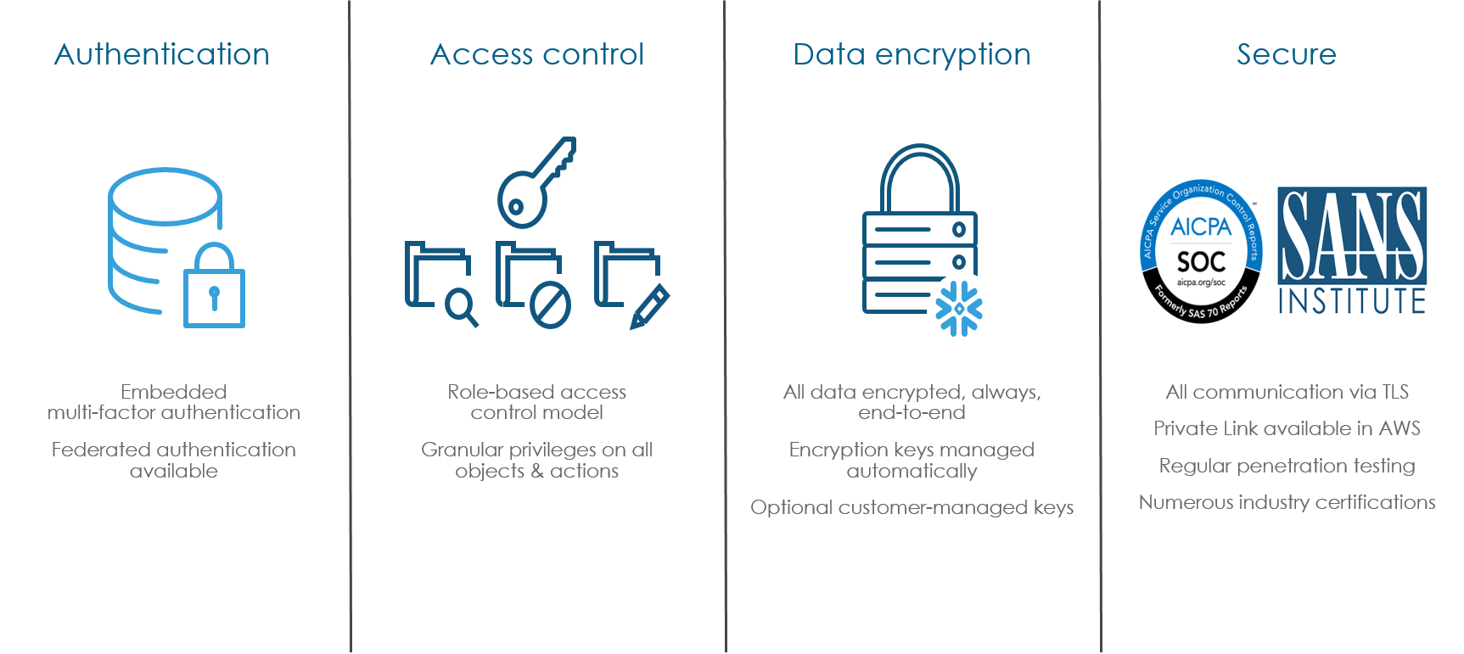
Enterprise-Grade Security
Notes:
Access Control Framework
Snowflake’s approach to access control combines aspects from both of the following models:
Discretionary Access Control (DAC): Each object has an owner, who can in turn grant access to that object.
Role-based Access Control (RBAC): Access privileges are assigned to roles, which are in turn assigned to users.
The key concepts to understanding access control in Snowflake are:
Securable object: An entity to which access can be granted. Unless allowed by a grant, access will be denied.
Role: An entity to which privileges can be granted. Roles are in turn assigned to users. Note that roles can also be assigned to other roles, creating a role hierarchy.
Privilege: A defined level of access to an object. Multiple distinct privileges may be used to control the granularity of access granted.
User: A user identity recognized by Snowflake, whether associated with a person or program. In the Snowflake model, access to securable objects is allowed via privileges assigned to roles, which are in turn assigned to other roles or users. In addition, each securable object has an owner that can grant access to other roles. This model is different from a user-based access control model, in which rights and privileges are assigned to each user or group of users. The Snowflake model is designed to provide a significant amount of both control and flexibility.
Secure views for sensitive data

Slide 16
Advanced Learning & Documentation
Snowflake offers advanced learning materials and technical architecture overviews via their online documentation
https://docs.snowflake.net/manuals/index.html
Readable and accessible to all levels of technicality, so long as reader has base familiarity with SQL

Slide 17
Snowflake Architecture Q&A
?

Slide 18
Technical Overview
Snowflake Training

Slide 19
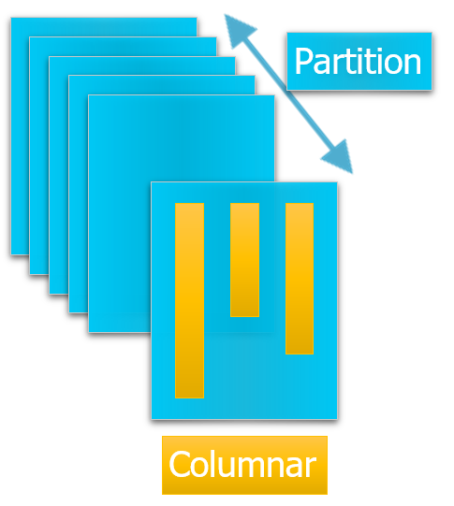
Micro Partitioning
Data is automatically partitioned on ingestion order
Metadata maintains data distribution for each column/sub-column and each partition
Micro
Partitions are intentionally kept small
Enables very fine-grained pruning
System designed to handle millions of partitions
50-500MB uncompressed data
Immutable
New files are created to reflect new final state of data when updates are performed
Old files are retained and versioned in metadata
Notes:
Helpful documentation: https://docs.snowflake.net/manuals/user-guide/tables-micro-partitions.html#micro-partitions
All data in Snowflake tables is automatically divided into micro-partitions, which are contiguous units of storage.
Does not require a partition scheme to be defined up front.
Partitions are created based upon natural ingestion order; this avoids skew between partitions and maintains correlations between columns which could be useful for pruning.
Each micro-partition contains between 50 MB and 500 MB of uncompressed data (note that the actual size in Snowflake is smaller because data is always stored compressed).
Groups of rows in tables are mapped into individual micro-partitions, organized in a columnar fashion.
This size and structure allows for extremely granular pruning of very large tables, which can be comprised of millions, or even hundreds of millions, of micro-partitions.
True columnar storage format--this enables vertical pruning by column within each partition in addition to the horizontal partition pruning.
Micro-partitions deliver all the advantages of static partitioning commonly relied upon in traditional data warehouses without the known limitations, as well as provide additional significant benefits.
Snowflake tracks metadata about all rows stored in a micro-partition, including:
The range of values for each of the columns in the micro-partition.
The number of distinct values.
Additional properties used for both optimization and efficient query processing.
Essentially a zone map, which maintains the data distribution for each column and sub-column in each partition.
This metadata allows some queries (MIN, MAX, COUNT, etc) to be serviced without requiring a virtual warehouse. The statistics are automatically collected.

Slide 20
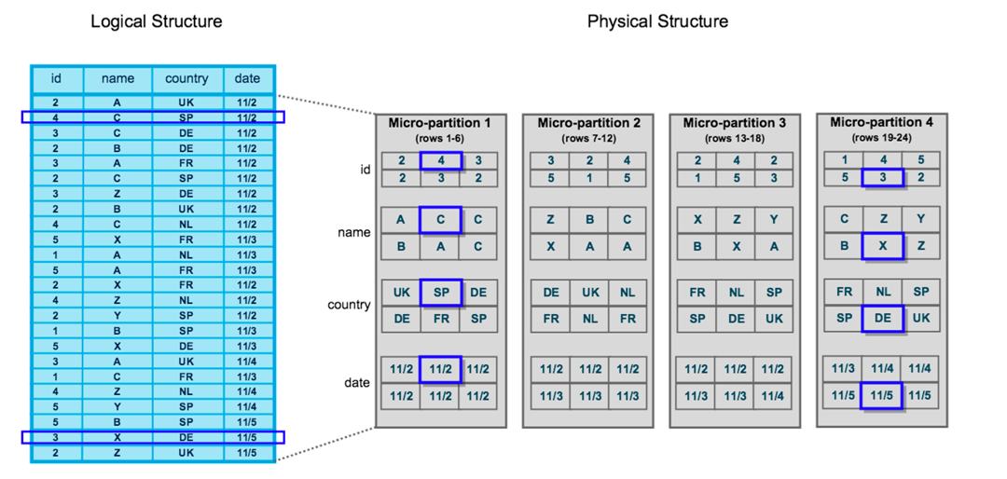
Micro Partitioning
Logical Structure
Physical Structure
Notes:
The entire row is in 1 micro partition
Helpful documentation: https://docs.snowflake.net/manuals/user-guide/tables-micro-partitions.html#micro-partitions

Slide 21
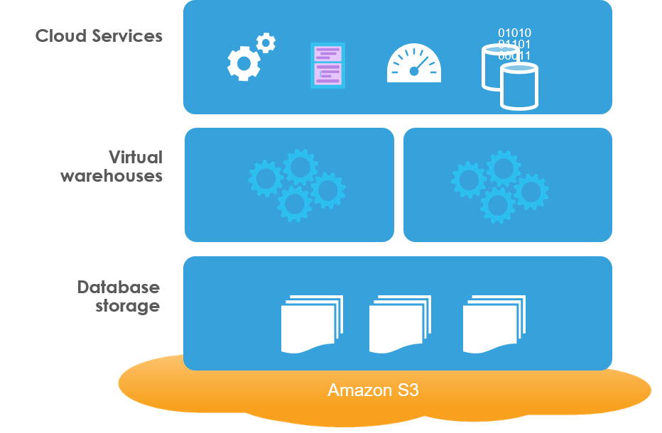
Dynamic Caching
Snowflake utilizes backend caching to store metadata reflective of the data stored within the Snowflake instance
Caching acts as a past and present archive of all data and operations
Metadata Cache
Query Cache
Virtual Warehouse Cache
Database Data
Notes:
3 levels of caching (for better performance)
Virtual Warehouse Cache
Query Cache (result set cache)
Metadata Cache
Immutable data means each operation dynamically stores metadata that creates your end results
No longer need to worry about costly delays after making mistakes that previously required database restores - makes development much more iterative and agile in nature

Slide 22
Metadata Cache
Micro-partition files are stored in the metadata cache in Snowflake-proprietary format
Metadata Cache enables zero-copy cloning capabilities
Cloned object is considered an entirely new object
Any privileges on the source object are retained on the cloned object
Any privileges granted on the source object are not transferred to the cloned object
Notes:
Metadata Cache
LRU (Least Recently Used) cache
Cannot be configured or turned on/off—fully-managed within Global Services layer
Contains a combination of logical and statistical metadata
Used primarily for compilation (plan generation)
Also used for SHOW commands or queries against INFORMATION SCHEMA

Slide 23
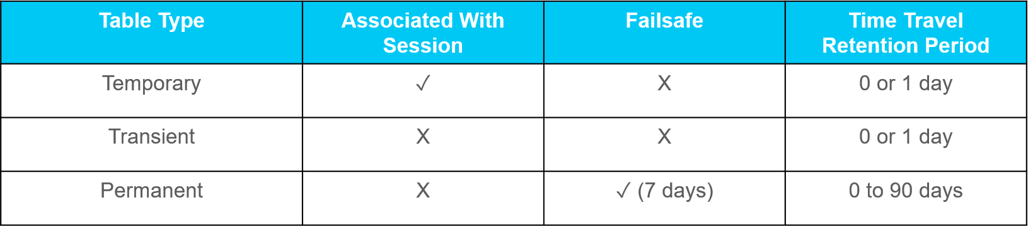
Time Travel
Enables instant roll-back to protect against user error, processing error or data corruption
Old micro-partition files are retained and queried to “roll-back” instance to a point within retention window
Different table types hold different retention windows
Preset by user between 0 and 90 days
Notes:
Helpful documentation: https://docs.snowflake.net/manuals/user-guide/data-lifecycle.html , https://docs.snowflake.net/manuals/user-guide/data-availability.html
Enables accessing historical data (i.e. data that has been changed or deleted) at any point within a defined period
Standard is 1 day; Enterprise and above supports up to 90 days
Facilitates:
Restoring deleted data-related objects (tables, schemas, and databases)
Duplicating and backing up data from key points in the past
Analyzing data usage/manipulation over specified periods of time
When the retention period ends for an object, the historical data is purged from Snowflake
Data is not available for querying
Objects can no longer be cloned
Objects can no longer be restored
Automatically enabled with the standard, 1-day retention period; default for Enterprise (and higher) accounts can be set to up to 90-days
Cannot be disabled for an account; however, it can be disabled for individual databases, schemas, and tables
Data retention period is set using the DATA_RETENTION_TIME_IN_DAYS parameter at the account of object (database, schema, table) level

Slide 24
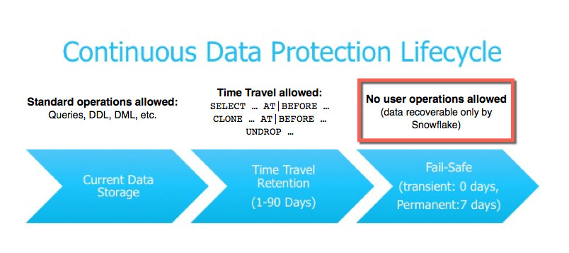
Architecture: Failsafe
Fail-safe ensures historical data is protected in the event of a system failure
Provides a non-configurable 7 day retention window in which data can be recovered
This period starts immediately after the time travel window ends
Operations are performed by Snowflake, not by the user
Notes:
Helpful documentation: https://docs.snowflake.net/manuals/user-guide/data-failsafe.html
Storage fees are incurred for maintaining historical data during both the Time Travel and Fail-safe periods
Calculated for each 24-hour period (i.e. 1 day) from the time the data changed
Snowflake minimizes the amount of storage required for historical data by maintaining only the information required to restore the individual table rows that were updated or deleted—full copies of tables are only maintained when tables are dropped or truncated
Temporary and Transient tables can be used to reduce costs

Slide 25
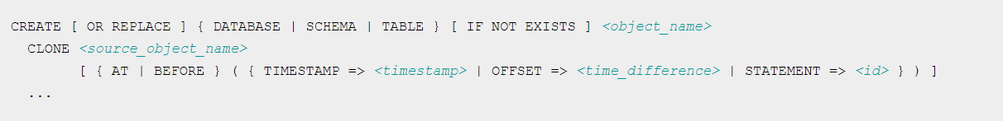
Zero-Copy Cloning
Zero-Copy cloning enables you to quickly create a copy of an object within your Snowflake instance
If you are utilizing time-travel feature, be sure to include AT or BEFORE clause in the execution statement
Notes:
Talk about utilizing this for sandboxing
Helpful Documentation: https://docs.snowflake.net/manuals/sql-reference/sql/create-clone.html

Slide 26
Query Cache
All queries and results are stored in query cache for 24 hours
Query cache enables optimized query response and execution
The power of caching can be viewed in the query execution plan
Notes:
Result Set Cache
Fastest way to retrieve data from Snowflake service
Managed entirely within Global Services layer
Result sets are cached in Cloud Storage layer
No resources from Virtual Warehouse layer are utilized
Note: compilation is STILL REQUIRED
Eligibility requirements for query to use result set cache…
Exact same SQL query (* except maybe whitespace)
Result must be deterministic (eg. no random function)
Recently extended to allow CURRENT_DATE()
Changes CAN be made to source table(s), but only if NONE affect any micro-partitions relevant to query
Result sets are stored for 24 hours; counter resets each time matching query is re-used
View in History in Web GUI to see the difference in execution plan

Slide 27
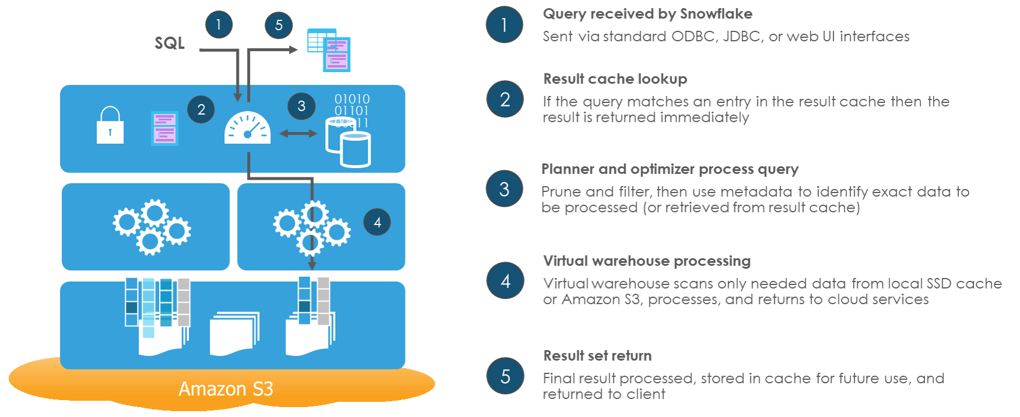
Architecture: Query Execution
Notes:
Helpful Documentation: https://docs.snowflake.net/manuals/user-guide/intro-key-concepts.html#query-processing
Query Processing
Query execution is performed in the processing layer.
Snowflake processes queries using “virtual warehouses”. Each virtual warehouse is an MPP compute cluster composed of multiple compute nodes allocated by Snowflake from a cloud provider.
Each virtual warehouse is an independent compute cluster that does not share compute resources with other virtual warehouses. As a result, each virtual warehouse has no impact on the performance of other virtual warehouses.

Slide 28
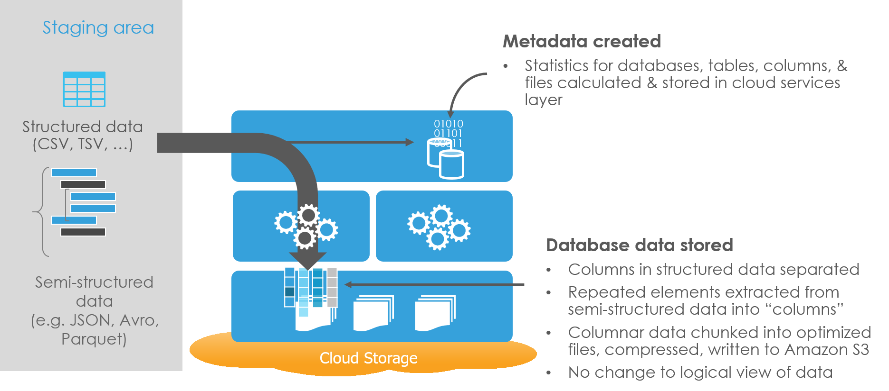
How It Works: Data Loading
Notes:
Helpful Documentation: https://docs.snowflake.net/manuals/user-guide/data-load-overview.html
Remove contention from ETL/ELT workloads with dedicated separate warehouse(s)
Snowflake Stage concept—a single place to land and stage your data
Broad support of file formats and compression schemes
Support for transformation—inbound and post-load
Optimization for both structured and semi-structured data
Built in validations, error management, monitoring

Slide 29
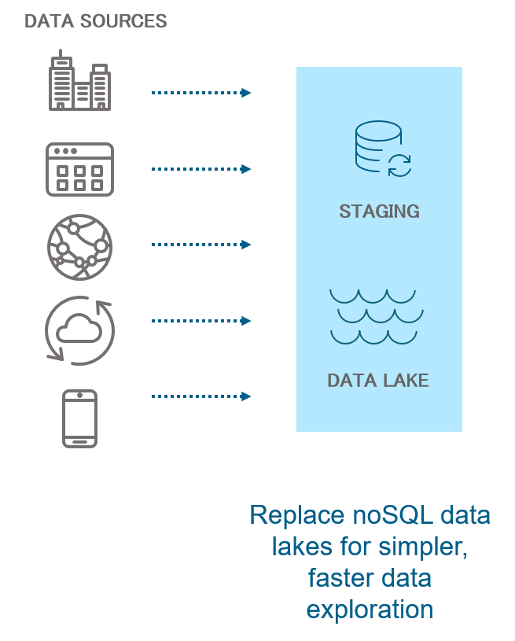
How It Works: Staging
Data loading is performed in two, separate steps
Initial step involves uploading files into an internal or external staging area
Internal Staging:
Files placed in Snowflake managed storage
Once dropped, files are gone and not recoverable
External Staging:
Amazon S3 or Azure Blob Storage
Once dropped, files persist in external cloud storage
Pass credentials to access cloud object location
Notes:
Helpful documentation: https://docs.snowflake.net/manuals/sql-reference/sql/create-stage.html

Slide 30
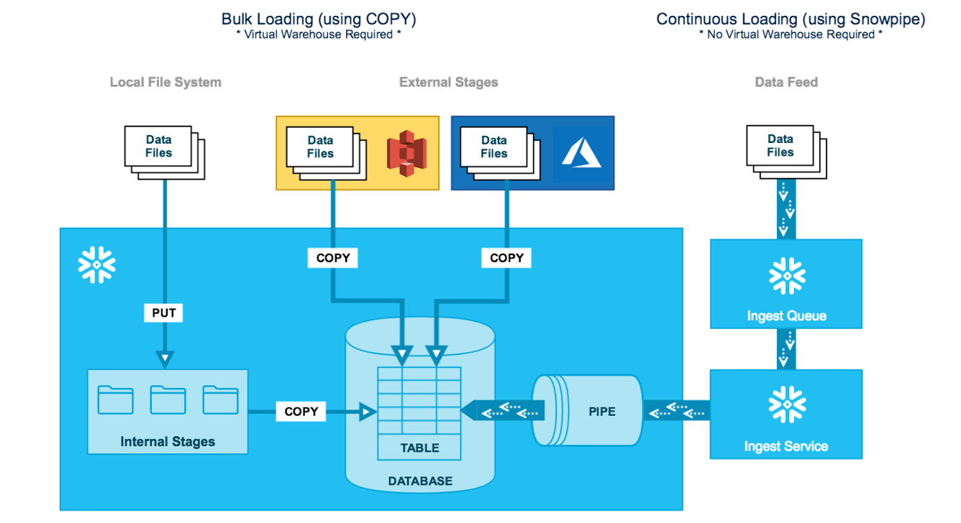
Data Loading
Bulk Loading:
Local Files
Cloud Staging
Continuous Loading
Snowpipe
Serverless Model
Notes:
Data will be clustered in the order they are loaded - important for initial/historical loads
This can make a big impact on performance
Helpful documentation: https://docs.snowflake.net/manuals/user-guide/data-load-overview.html
Troubleshooting: https://docs.snowflake.net/manuals/user-guide/data-load-considerations-ts.html

Slide 31
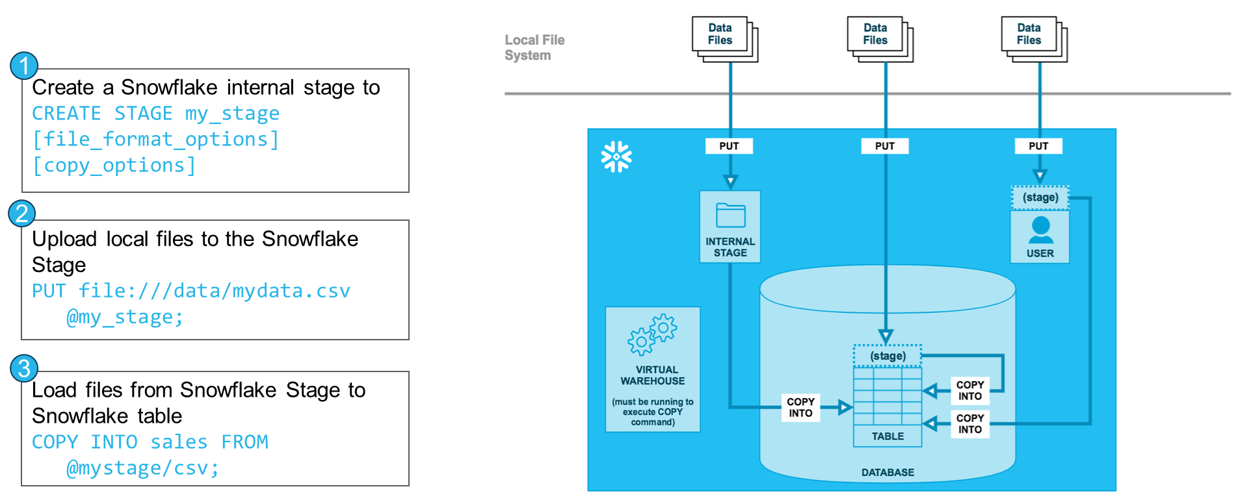
SQL - Bulk Loading
Notes:
Helpful documentation: https://docs.snowflake.net/manuals/user-guide/data-load-local-file-system.html

Slide 32
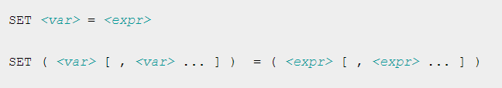
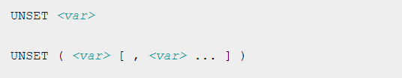

Variables
Snowflake also has the ability to set SQL variables for your instance
These can be used to store application-specific environment variables
Notes:
Helpful Documentation: https://docs.snowflake.net/manuals/sql-reference/session-variables.html

Slide 33
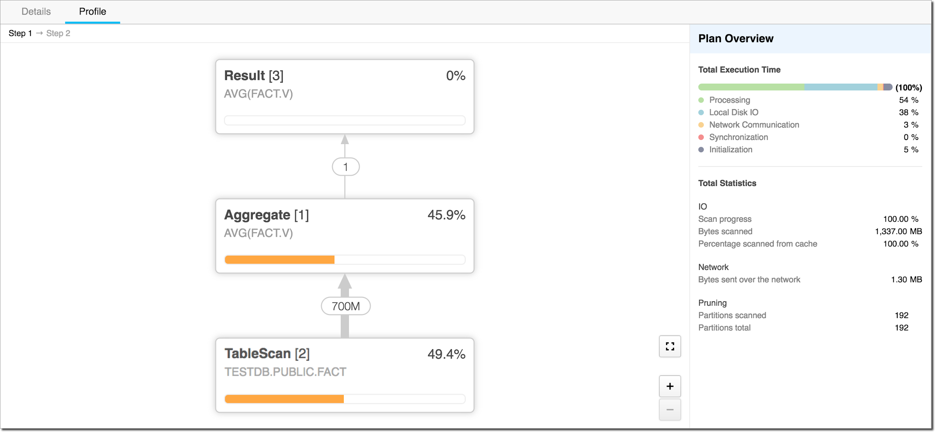
Diagnosing a Slow-Running Query
History Page (Web Interface)
If the Status column displays a status of Queued for the query, the cause of the slowness is most likely due to insufficient compute resources. If the running query load is high or there’s queuing, consider starting a separate warehouse and moving queued queries to that warehouse.
QUERY_HISTORY Functions
select * from table(information_schema.query_history()) order by start_time;
Query Profile (Web Interface)
Provides execution details for a query. For the selected query, it provides a graphical representation of the main components of the processing plan for the query, with statistics for each component, along with details and statistics for the overall query.
Link to performance tuning tips
Notes:
Analyzing queries: https://docs.snowflake.net/manuals/user-guide/ui-query-profile.html

Slide 34
SnowSQL
Snowflake has a proprietary command-line interface (CLI) for more advanced functions and commands
Can also be used if you don’t want to use the GUI
https://docs.snowflake.net/manuals/user-guide/snowsql-install-config.html

Slide 35
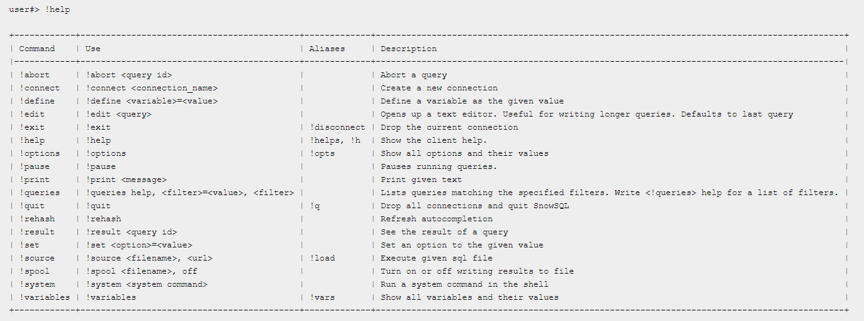
SnowSQL Commands
All SnowSQL commands are executed beginning with an exclamation point (!)
Notes:
Helpful Documentation: https://docs.snowflake.net/manuals/user-guide/snowsql-use.html

Slide 36
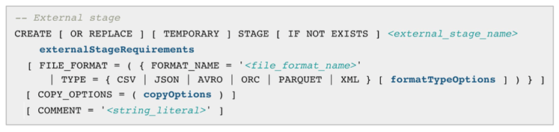
SQL - Staging
Various types of stages:
Internal
Files to be placed in Snowflake managed storage
Use PUT command to place local files in internal stage
External
Amazon S3 of Microsoft Blob Storage
Pass credentials to access cloud object storage location
Stage options include:
Specify explicit file format and compression (optional)
Credentials
Error management
Validation practices
Notes:
Helpful Documentation: https://docs.snowflake.net/manuals/user-guide/data-load-considerations-stage.html
Staging and Validation
Use staging tables to manage transformation of imported data, if possible
Validate the data before loading into Snowflake target table

Slide 37
Performance and Design Tips
Loading
Sizing
Data Modeling
Usage Tracking
Optimizing SQL Development
Storage
Notes:
Tuning Tips: https://docs.google.com/document/d/1xjRNoJSFwurJC_nvYifpJ7ekDUoNVxFJHWYNkOzOUvM/edit?usp=sharing

Slide 38
GUI Walkthrough
Snowflake Training

Slide 39
Navigate to Snowflake Instance
https://js51932.us-east-1.snowflakecomputing.com/

Slide 40
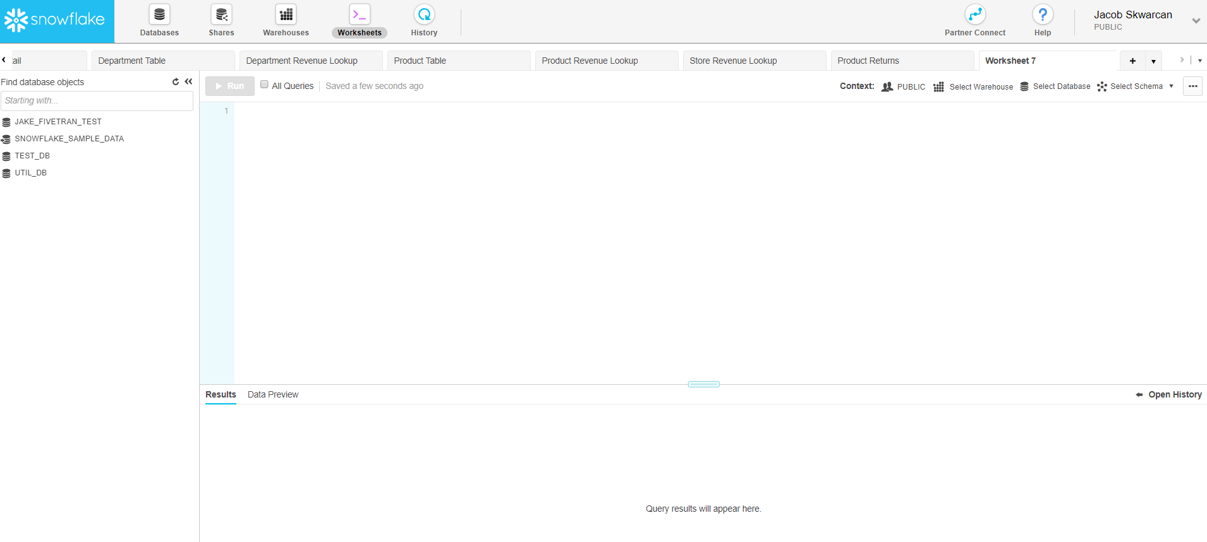
The GUI

Slide 41
The GUI - Your User

Slide 42
The GUI - Your Databases

Slide 43
The GUI - Worksheets

Slide 44
The GUI - Worksheet Configuration

Slide 45
The GUI - Workspace

Slide 46
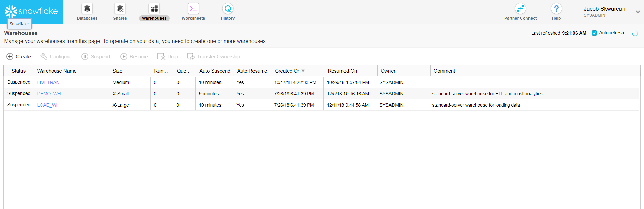
The GUI - Warehouse Tab

Slide 47
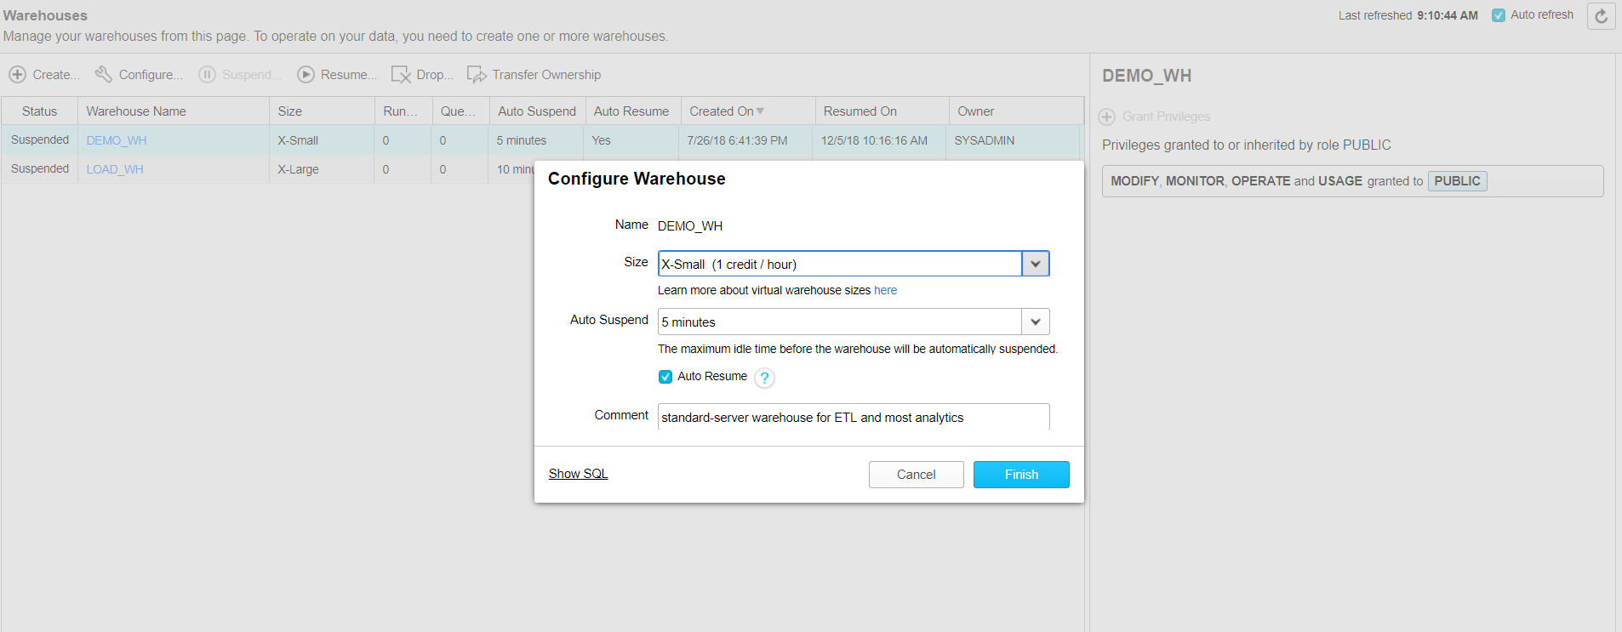
The GUI - Warehouse Configuration

Slide 48
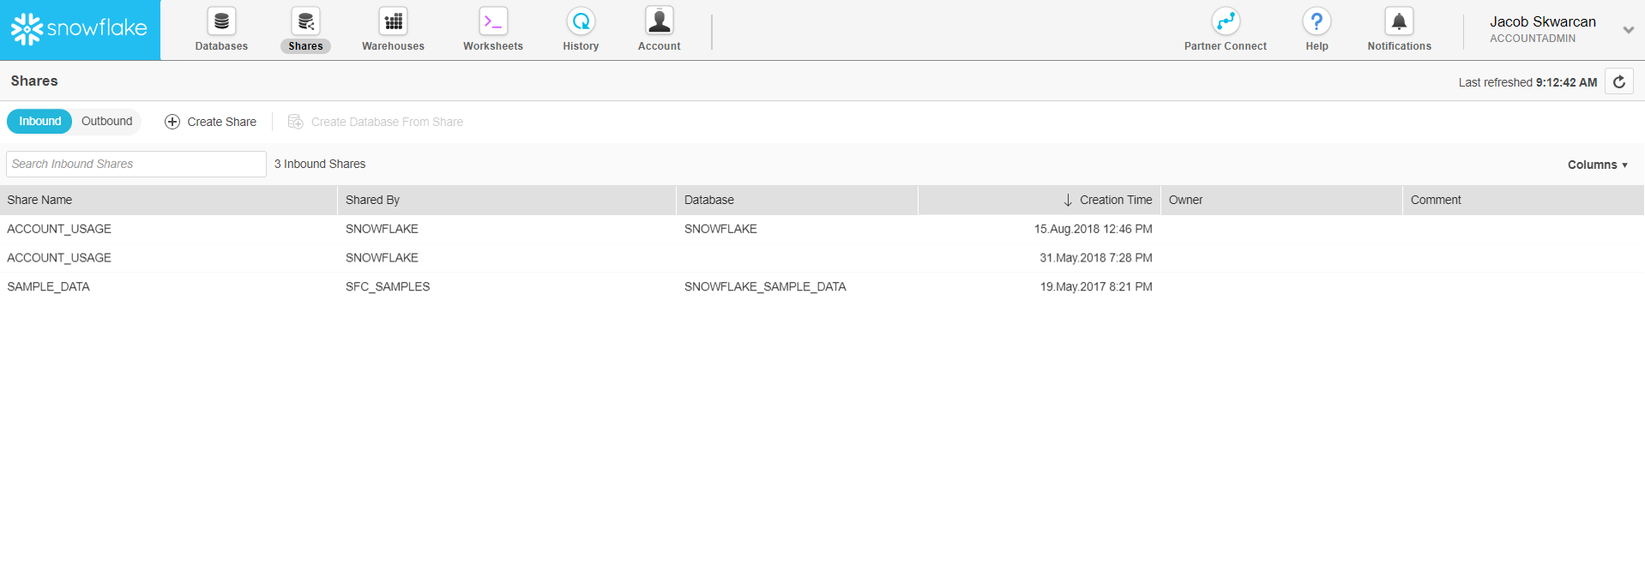
The GUI - Sharing

Slide 49
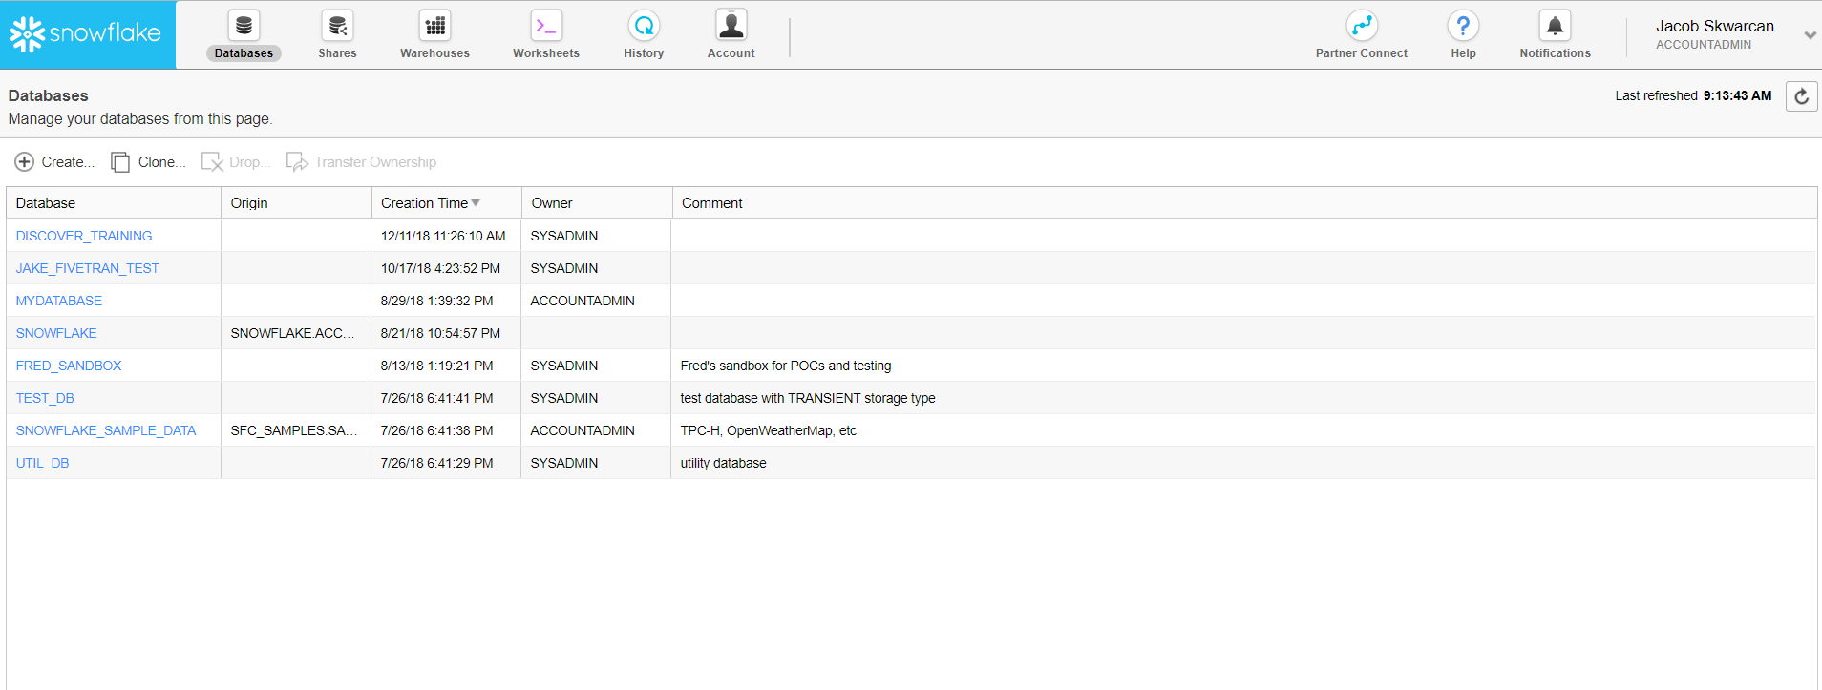
The GUI - Databases

Slide 50
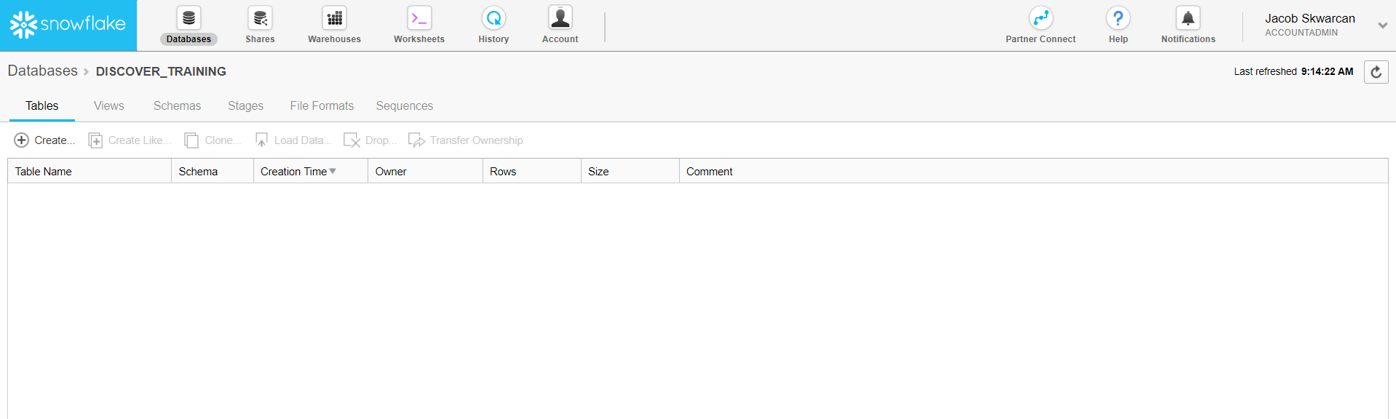
The GUI - Database Contents

Slide 51
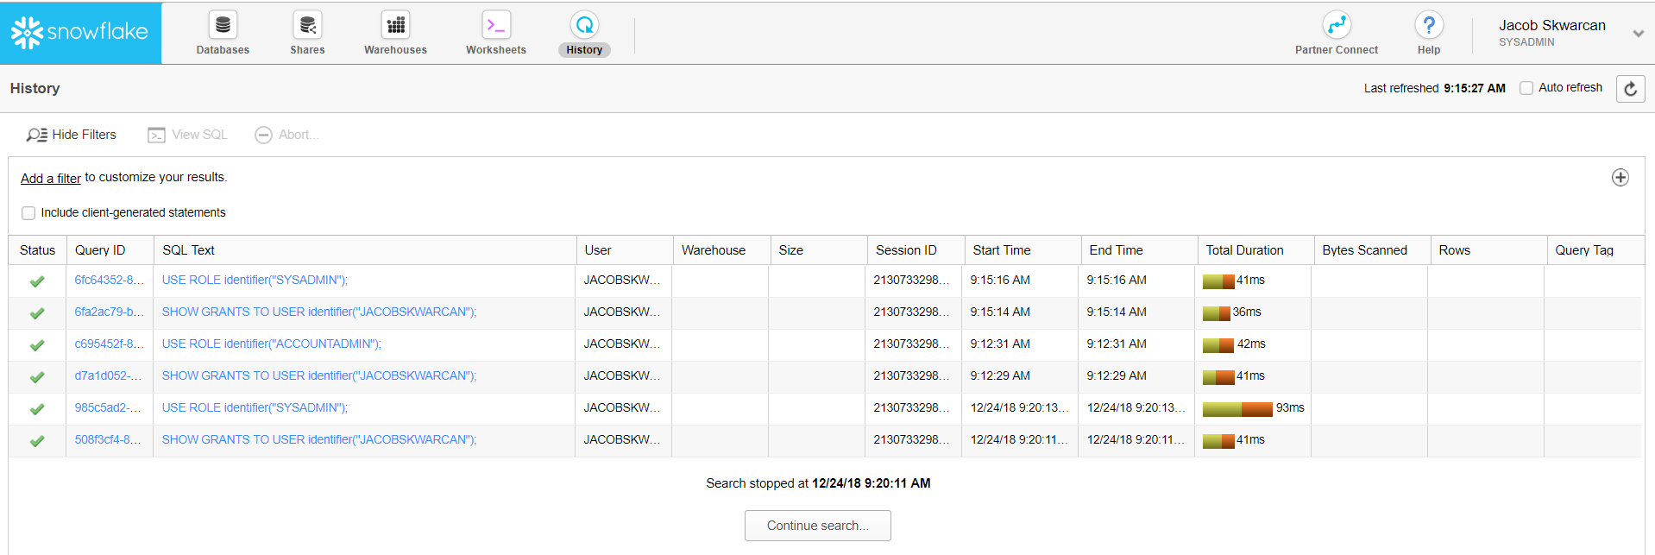
The GUI - History

Slide 52
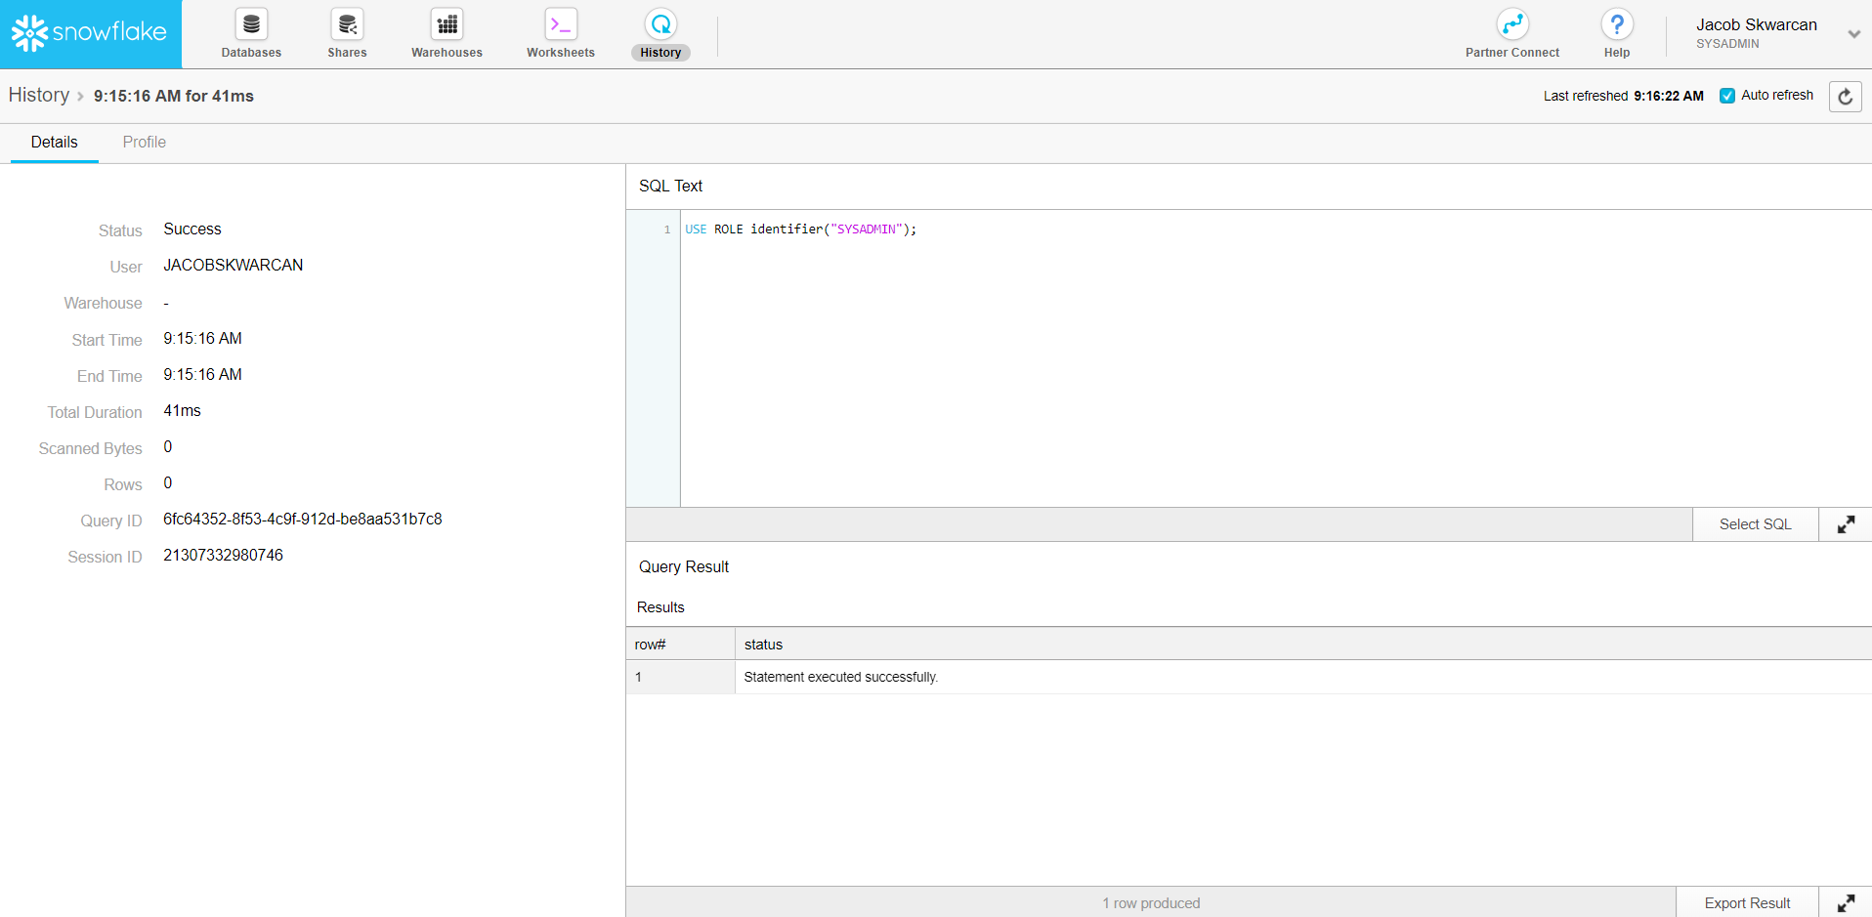
The GUI - Query Details

